Slide 1
Foundations of Modern Networking
SDN, NFV, QoE, IoT, and Cloud
By: William Stallings

Slide 2
Chapter 2
Requirements and Technology
Notes:
Chapter Objectives
After studying this chapter, you should be able to
■ Present an overview of the major categories of packet traffic on the Internet and internets,
including elastic, inelastic, and real-time traffic.
■ Discuss the traffic demands placed on contemporary networks by big data, cloud
computing, and mobile traffic.
■ Explain the concept of quality of service.
■ Explain the concept of quality of experience.
■ Understand the essential elements of routing.
■ Understand the effects of congestion and the types of techniques used for congestion
control.
■ Compare and contrast software-defined networking and network functions virtualization.

Slide 3
Types of Network and Internet Traffic
Elastic Traffic
Can adjust, over wide ranges, to changes in delay and throughput across an internet and still meet the needs of its applications
Is the traditional type of traffic supported on TCP/IP based internets
Is the type of traffic for which internets were designed
Applications that generate such traffic typically use Transmission Control Protocol (TCP) or User Datagram Protocol (UDP) as a transport protocol
Notes:
Elastic traffic is that which can adjust, over wide ranges, to changes in delay and
throughput across an internet and still meet the needs of its applications. This is
the traditional type of traffic supported on TCP/IP-based internets and is the type
of traffic for which internets were designed. Applications that generate such traffic
typically use Transmission Control Protocol (TCP) or User Datagram Protocol (UDP)
as a transport protocol. In the case of UDP, the application will use as much capacity
as is available up to the rate that the application generates data. In the case of TCP, the
application will use as much capacity as is available up to the maximum rate that the
end-to-end receiver can accept data. Also with TCP, traffic on individual connections
adjusts to congestion by reducing the rate at which data are presented to the network.
Applications that can be classified as elastic include the common applications that
operate over TCP or UDP, including file transfer (File Transfer Protocol / Secure FTP
[FTP/SFTP]), electronic mail (Simple Mail Transport Protocol [SMTP]), remote login
(Telnet, Secure Shell [SSH]), network management (Simple Network Management
Protocol [SNMP]), and web access (Hypertext Transfer Protocol / HTTP Secure
[HTTP/HTTPS]). However, there are differences among the requirements of these
applications, including the following:
■ E-mail is generally insensitive to changes in delay.
■ When file transfer is done via user command rather than as an automated background
task, the user expects the delay to be proportional to the file size and so
is sensitive to changes in throughput.
■ With network management, delay is generally not a serious concern. However,
if failures in an internet are the cause of congestion, then the need for SNMP
messages to get through with minimum delay increases with increased
congestion.
■ Interactive applications, such as remote logon and web access, are sensitive to
delay.
It is important to realize that it is not per-packet delay that is the quantity of interest.
Observation of real delays across the Internet suggest that wide variations in delay do
not occur. Because of the congestion control mechanisms in TCP, when congestion
develops, delays only increase modestly before the arrival rate from the various TCP
connections slow down. Instead, the quality of service (QoS) perceived by the user
relates to the total elapsed time to transfer an element of the current application. For
an interactive Telnet-based application, the element may be a single keystroke or
single line. For web access, the element is a web page, which could be as little as a
few kilobytes or could be substantially larger for an image-rich page. For a scientific
application, the element could be many megabytes of data.
For very small elements, the total elapsed time is dominated by the delay time across
the Internet. However, for larger elements, the total elapsed time is dictated by the
sliding-window performance of TCP and is therefore dominated by the throughput
achieved over the TCP connection. Thus, for large transfers, the transfer time is
proportional to the size of the file and the degree to which the source slows because
of congestion.
It should be clear that even if you confine your attention to elastic traffic, some service
prioritizing and controlling traffic could be of benefit. Without such a service, routers
are dealing evenhandedly with arriving IP packets, with no concern for the type of
application and whether a particular packet is part of a large transfer element or a
small one. Under such circumstances, and if congestion develops, it is unlikely that
resources will be allocated in such a way as to meet the needs of all applications fairly.
When inelastic traffic is added to the mix, the results are even more unsatisfactory.

Slide 4
Types of Network and Internet Traffic
Inelastic Traffic
Does not easily adapt, if at all, to changes in delay and throughput across an internet
Examples of inelastic traffic include: multimedia transmission such as voice and video, and high-volume interactive traffic
Requirements may include:
Throughput
A minimum throughput value may be required
Delay
Also called latency
Delay jitter
The magnitude of delay variation is a critical factor in real-time applications
Notes:
Inelastic traffic does not easily adapt, if at all, to changes in delay and throughput
across an internet. Examples of inelastic traffic include multimedia transmission,
such as voice and video, and high-volume interactive traffic, such as an interactive
simulation application (for example, airline pilot simulation). The requirements for
inelastic traffic may include the following:
■ Throughput: A minimum throughput value may be required. Unlike most
elastic traffic, which can continue to deliver data with perhaps degraded service,
many inelastic applications absolutely require a given minimum throughput.
■ Delay : Also called latency. An example of a delay-sensitive application is
stock trading; someone who consistently receives later service will consistently
act later, and with greater disadvantage.
■ Delay jitter: The magnitude of delay variation, called delay jitter , or simply
jitter, is a critical factor in real-time applications. Because of the variable
delay imposed by an internet, the interarrival times between packets are not
maintained at a fixed interval at the destination. To compensate for this, the incoming
packets are buffered, delayed sufficiently to compensate for the jitter, and then
released at a constant rate to the software that is expecting a steady
real-time stream. The larger the allowable delay variation, the longer the real
delay in delivering the data and the greater the size of the delay buffer required
at receivers. Real-time interactive applications, such as teleconferencing, may
require a reasonable upper bound on jitter.
■ Packet loss : Real-time applications vary in the amount of packet loss, if any,
that they can sustain.

Slide 5
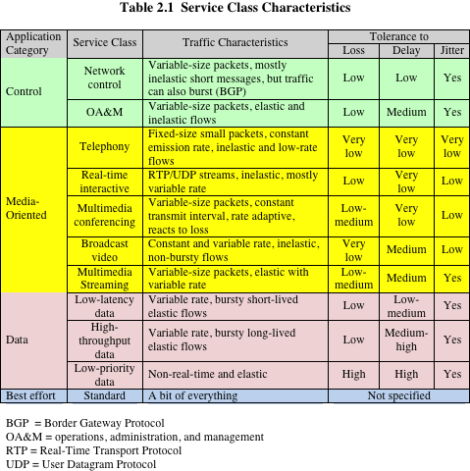
Notes:
Table 2.1 shows the loss, delay, and jitter characteristics of various classes of traffic,
as specified in RFC 4594 (Configuration Guidelines for DiffServ Service Classes ,
August 2006). Table 2.2 gives examples of QoS requirements for various media-oriented
applications [SZIG14].

Slide 6
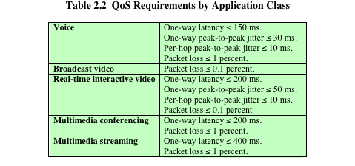
Notes:
These requirements are difficult to meet in an environment with variable queuing
delays and congestion losses. Accordingly, inelastic traffic introduces two new
requirements into the internet architecture. First, some means is needed to give preferential
treatment to applications with more demanding requirements. Applications
need to be able to state their requirements, either ahead of time in some sort of service
request function, or on the fly, by means of fields in the IP packet header. The former
approach provides more flexibility in stating requirements, and it enables the network
to anticipate demands and deny new requests if the required resources are unavailable.
This approach implies the use of some sort of resource reservation protocol.
An additional requirement in supporting inelastic traffic in an internet architecture is
that elastic traffic must still be supported. Inelastic applications typically do not back
off and reduce demand in the face of congestion, in contrast to TCP-based applications.
Therefore, in times of congestion, inelastic traffic will continue to supply a
high load, and elastic traffic will be crowded off the internet. A reservation protocol
can help control this situation by denying service requests that would leave too few
resources available to handle current elastic traffic.

Slide 7
Real-Time Traffic Characteristics
An example of inelastic traffic
Are concerned with timing issues as well as packet loss
In most cases there is a requirement that data be delivered at a constant rate equal to the sending rate
In other cases a deadline is associated with each block of data, such that the data are not usable after the deadline has expired
Notes:
As mentioned, a common example of inelastic traffic is real-time traffic . With
traditional elastic applications, such as file transfer, electronic mail, and client/server
applications including the web, the performance metrics of interest are generally
throughput and delay. There is also a concern with reliability, and mechanisms are
used to make sure that no data are lost, corrupted, or misordered during transit. By
contrast, real-time applications are concerned with timing issues as well as packet
loss. In most cases, there is a requirement that data be delivered at a constant rate
equal to the sending rate. In other cases, a deadline is associated with each block of
data, such that the data are not usable after the deadline has expired.

Slide 8
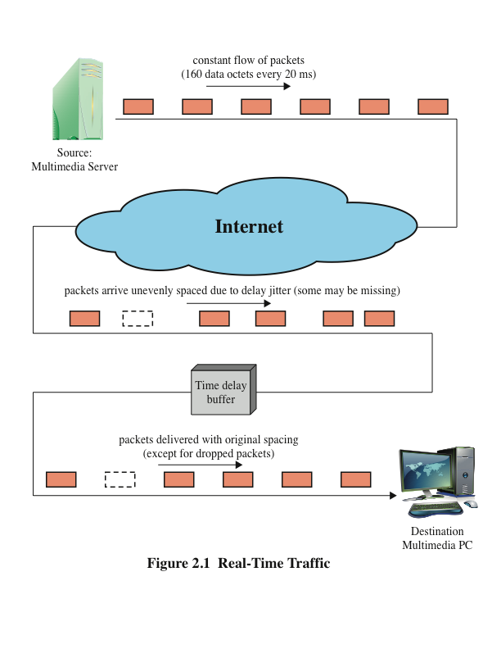
Notes:
Figure 2.1 illustrates a typical real-time environment. Here, a server is generating
audio to be transmitted at 64 kbps. The digitized audio is transmitted in packets
containing 160 octets of data, so that one packet is issued every 20 ms. These packets
are passed through an internet and delivered to a multimedia PC, which plays the
audio in real time as it arrives. However, because of the variable delay imposed by the
internet, the interarrival times between packets are not maintained at a fixed 20 ms at
the destination. To compensate for this, the incoming packets are buffered, delayed
slightly, and then released at a constant rate to the software that generates the audio.
The buffer may be internal to the destination machine or in an external network device.
The compensation provided by the delay buffer is limited. For example, if the
minimum end-to-end delay seen by any packet is 1 ms and the maximum is 6 ms, the
delay jitter is 5 ms. As long as the time delay buffer delays incoming packets by at
least 5 ms, the output of the buffer will include all incoming packets. However, if the
buffer delayed packets by only 4 ms, any incoming packets that had experienced a
relative delay of more than 4 ms (an absolute delay of more than 5 ms) would have to
be discarded so as not to be played back out of order.

Slide 9
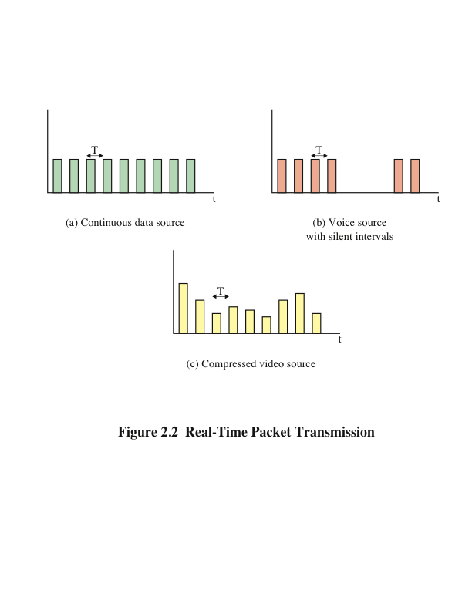
Notes:
The description of real-time traffic so far implies a series of equal-size packets
generated at a constant rate. This is not always the profile of the traffic. Figure 2.2
illustrates some of the common possibilities, as described in the list that follows.
■ Continuous data source: Fixed-size packets are generated at fixed intervals.
This characterizes applications that are constantly generating data, have
few redundancies, and that are too important to compress in a lossy way. Examples
are air traffic control radar and real-time simulations.
■ On/off source: The source alternates between periods when fixed-size
packets are generated at fixed intervals and periods of inactivity. A voice
source, such as in telephony or audio conferencing, fits this profile.
■ Variable packet size : The source generates variable-length packets at uniform
intervals. An example is digitized video in which different frames may
experience different compression ratios for the same output quality level.

Slide 10
Big Data
Refers to everything that enables an organization to create, manipulate, and manage very large data sets and the facilities in which these are stored
Infrastructure
Rational database management systems (RDBMS)
Network-attached storage (NAS)
Storage area networks (SANs)
Data warehouses (DWs)
Business intelligence (BI) analytics
Notes:
In simple terms, big data refers to everything that enables an organization to create,
manipulate, and manage very large data sets (measured in terabytes, petabytes,
exabytes, and so on) and the facilities in which these are stored. Distributed data
centers, data warehouses, and cloud-based storage are common aspects of today’s
enterprise networks. Many factors have contributed to the merging of “big data” and
business networks, including continuing declines in storage costs, the maturation of
data mining and business intelligence (BI) tools, and government regulations and
court cases that have caused organizations to stockpile large masses of structured
and unstructured data, including documents, e-mail messages, voice-mail messages,
text messages, and social media data. Other data sources being captured, transmitted,
and stored include web logs, Internet documents, Internet search indexing, call detail
records, scientific research data and results, military surveillance, medical records,
video archives, and e-commerce transactions.
Data sets continue to grow with more and more being gathered by remote sensors,
mobile devices, cameras, microphones, radio frequency identification (RFID) readers,
and similar technologies. One study from a few years ago estimated that 2.5 exabytes
(2.5 Å~ 1018 bytes) of data are created each day, and 90 percent of the data in the world
was created in the past two years [IBM11]. Those numbers are likely higher today.
Traditional business data storage and management technologies include relational
database management systems (RDBMS), network-attached storage (NAS), storagearea
networks (SANs), data warehouses (DWs), and business intelligence (BI)
Analytics.
Traditional data warehouse and BI analytics systems tend to be highly centralized
within an enterprise infrastructure. These often include a central data repository
with a RDBMS, high-performance storage, and analytics software, such as online
analytical processing (OLAP) tools for mining and visualizing data.
Increasingly, big data applications are becoming a source of competitive value for
businesses, especially those that aspire to build data products and services to profit
from the huge volumes of data that they capture and store. There is every indication
that the exploitation of data will become increasingly important to enterprises in the
years ahead as more and more businesses reap the benefits of big data applications.

Slide 11
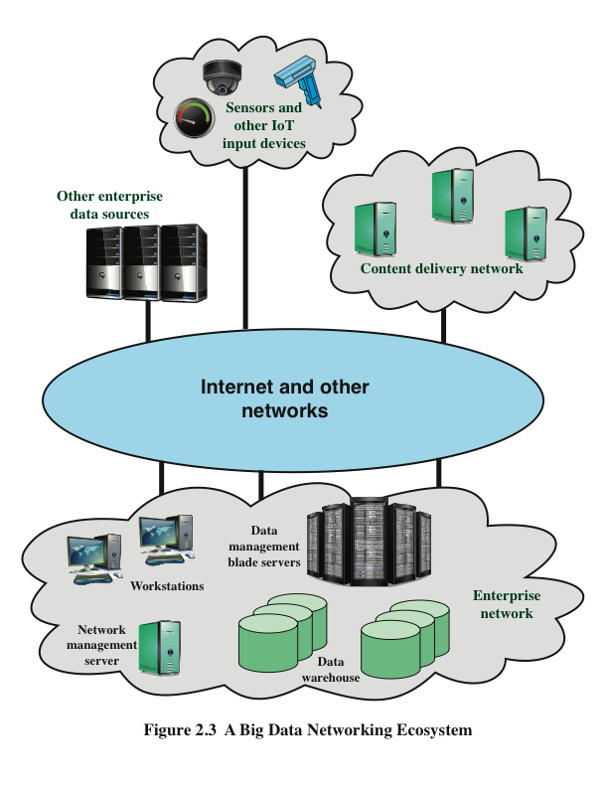
Notes:
To get some feel for the networking requirements for a typical big data system, consider
the example ecosystem of Figure 2.3 (compared to Figure 1.1 from Chapter 1).
Key elements within the enterprise include the following:
■ Data warehouse: The DW holds integrated data from multiple data sources,
used for reporting and data analysis.
■ Data management servers: Large banks of servers serve multiple functions
with respect to big data. The servers run data analysis applications, such
as data integration tools and analytics tools. Other applications integrate and
structure data from enterprise activity, such as financial data, point-of-sale
data, and e-commerce activity.
■ Workstations / data processing systems: Other systems involved
in the use of big data applications and in the generation of input to big data
warehouses.
■ Network management server: One or more servers responsible for network
management, control, and monitoring.
Not shown in Figure 2.3 are other important network devices, including firewalls,
intrusion detection/prevention systems (IDS/IPS), LAN switches, and routers.
The enterprise network can involve multiple sites distributed regionally, nationally, or
globally. In addition, depending on the nature of the big data system, an enterprise can
receive data from other enterprise servers, from dispersed sensors and other devices
in an Internet of Things, in addition to multimedia content from content delivery
networks.

Slide 12
Big Data
The impact of big data on an enterprise’s networking infrastructure is driven by the so-called three V’s:
Volume
Growing amounts of data
Velocity
Increasing speed in storing and reading data
Variability
Growing number of data type and sources
Notes:
The networking environment for big data is complex. The impact of big data on an
enterprise’s networking infrastructure is driven by the so-called three V ’s:
■ Volume (growing amounts of data)
■ Velocity (increasing speed in storing and reading data)
■ Variability (growing number of data types and sources)

Slide 13
Areas of Concern:
Network capacity
Running big data analytics requires a lot of capacity on its own; the issue is magnified when big data and day-to-day application traffic are combined over an enterprise network
Latency
The real or near-real-time nature of big data demands a network architecture with consistent low latency to achieve optimal performance
Storage capacity
Massive amounts of highly scalable storage are required to address the insatiable appetite of big data, yet these resources must be flexible enough to handle many different data formats and traffic loads
Processing
Big data can add significant pressure on computational memory and storage systems, which, if not properly addressed, can negatively impact operational efficiency
Secure data access
Big data projects combine sensitive information from many sources like customer transactions, GPS coordinated, video streams, and so on, which must be protected from unauthorized access
Notes:
Based on a Network World 2014 white paper, areas of concern include the following
[NETW14]:
■ Network capacity: Running big data analytics requires a lot of capacity on
its own; the issue is magnified when big data and day-to-day application traffic
are combined over an enterprise network.
■ Latency: The real or near-real-time nature of big data demands a network
architecture with consistent low latency to achieve optimal performance.
■ Storage capacity: Massive amounts of highly scalable storage are required
to address the insatiable appetite of big data, yet these resources must be
flexible enough to handle many different data formats and traffic loads.
■ Processing: Big data can add significant pressure on computational,
memory, and storage systems, which, if not properly addressed, can negatively
impact operational efficiency.
■ Secure data access: Big data projects combine sensitive information from
many sources like customer transactions, GPS coordinates, video streams, and
so on, which must be protected from unauthorized access.

Slide 14
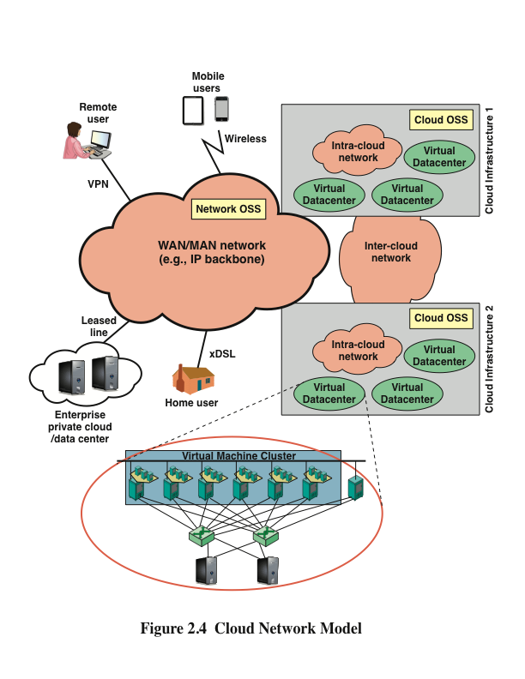
Notes:
As with big data installations, cloud computing presents imposing challenges for
effective and efficient flow of traffic through networks. It will be helpful in this regard
to consider the cloud network model developed by ITU-T, and shown in Figure 2.4
[ITUT12]. This figure indicates the scope of network concerns for cloud network and
service providers and for cloud service users.
A cloud service provider maintains one or more local or regional cloud infrastructures.
An intracloud network connects the elements of the infrastructure, including database
servers, storage arrays, and other servers (for example, firewalls, load balancers,
application acceleration devices, and IDS/IPS). The intracloud network will likely
include a number of LANs interconnected with IP routers. Within the infrastructure,
database servers are organized as a cluster of virtual machines , providing
virtualized, isolated computing environments for different users.
Intercloud networks interconnect cloud infrastructures together. These cloud
infrastructures may be owned by the same cloud provider or by different ones. Finally,
a core transport network is used by customers to access and consume cloud services
deployed within the cloud provider’s data center.
Also depicted in Figure 2.4 are two categories of operations support system (OSS):
■ Network OSS: The traditional OSS is a system dedicated to providers of telecommunication
services. The processes supported by a network OSS include
service management and maintenance of the network inventory, configuration
of particular network components, and fault management.
■ Cloud OSS: OSS of cloud infrastructure is the system dedicated to providers
of cloud computing services. Cloud OSS supports processes for the maintenance,
monitoring, and configuration of cloud resources.

Slide 15
Cloud Computing
Intracloud, intercloud, core, together with the OSS components, are the foundation of cloud services composition and delivery
Functional requirements for this network capability:
Scalability
Networks must be able to scale easily to meet the demands of moving from current cloud infrastructures of hundreds or a few thousand servers to networks of tens or even hundreds of thousands of servers
Performance
Traffic in both big data installations and cloud provider networks is unpredictable and quite variable
Agility and flexibility
The cloud-based data center needs to be able to respond and manage the highly dynamic nature of cloud resource utilization
Notes:
These three network components (intracloud, intercloud, core), together with the
OSS components, are the foundation of cloud services composition and delivery.
The ITU-T Focus Group on Cloud Computing Technical Report [ITUT12] lists the
following functional requirements for this network capability:
■ Scalability: Networks must be able to scale easily to meet the demands of
moving from current cloud infrastructures of hundreds or a few thousand
servers to networks of tens or even hundreds of thousands of servers. This
scaling presents challenges in areas such as addressing, routing, and congestion
control.
■ Performance: Traffic in both big data installations and cloud provider
networks is unpredictable and quite variable [KAND12]. There are sustained
spikes between nearby servers within the same rack and intermittent heavy traffic
with a single source server and multiple destination servers. Intracloud networks
need to provide reliable high-speed direct (logical point-to-point) communications
between servers with congestion-free links, and uniform capacity between
any two arbitrary servers within the data center. The ITU-T report concludes
that the current three-tier topology (access, aggregation, and core) used in data
centers is not well adapted to provide these requirements. A more flexible and
dynamic control of data flows, in addition to virtualization of network devices,
provides a better foundation for providing the desired quality of service.
■ Agility and flexibility : The cloud-based data center needs to be able to respond
and manage the highly dynamic nature of cloud resource utilization.
This includes the ability to adapt to virtual machine mobility and to provide
fine-grained control of flows routing through the data center.

Slide 16
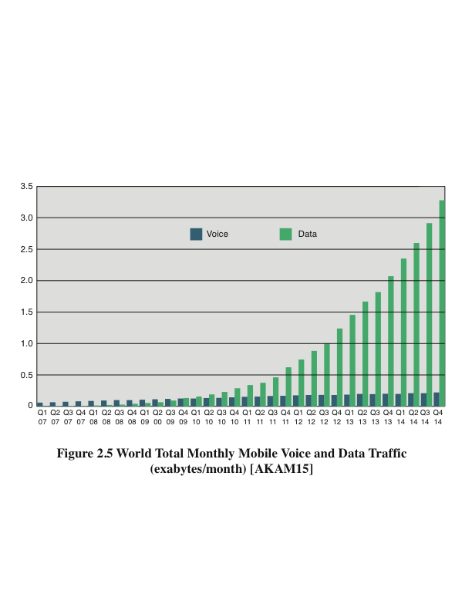
Notes:
The first rush to wireless was for voice. Now, the attention is on data; some wireless
devices are only rarely used for voice. Figure 2.5 shows the dramatic trend in world
total mobile traffic in 2G, 3G, and 4G networks (not including DVB-H, Wi-Fi, and
Mobile WiMAX) estimated by Ericsson [AKAM15]. Ericsson’s presence in more
than 180 countries and its customer base representing more than 1000 networks enable
it to measure mobile voice and data volumes. The result is a representative base for
calculating world total mobile traffic.
A big part of the mobile market is the wireless Internet. Wireless users use the Internet
differently than fixed users, but in many ways no less effectively. Wireless smartphones
have limited displays and input capabilities compared with larger devices
such as laptops or PCs, but mobile apps give quick access to intended information
without using websites. Because wireless devices are location aware, information can
be tailored to the geographic location of the user. Information finds users, instead of
users searching for information. Tablet devices provide a happy medium between the
larger screens and better input capabilities of PCs and the portability of smartphones.

Slide 17
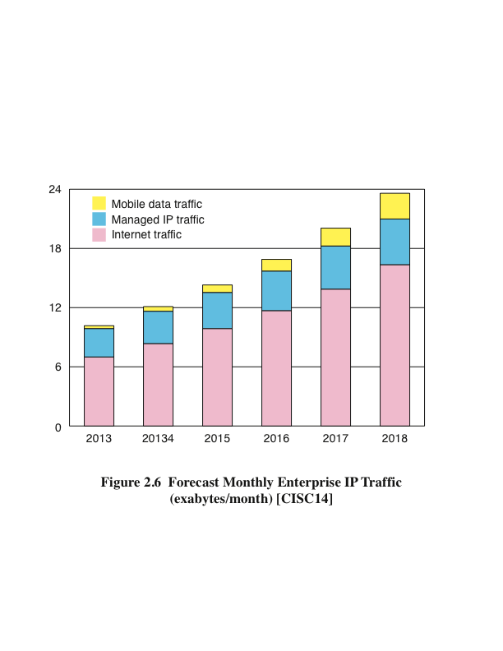
Notes:
Figure 2.6 shows a projection for mobile enterprise IP traffic [CISC14], where the
term enterprise refers to businesses and governments. Cisco’s methodology rests on a
combination of analyst projections, in-house estimates and forecasts, and direct data
collection. As with mobile data traffic over cellular networks, mobile enterprise IP
traffic is on a strong growth curve.
Figure 2.6 breaks the mobile traffic down into three categories:
■ Mobile data traffic: All enterprise traffic that crosses a mobile access point
■ Managed IP traffic: All enterprise traffic that is transported over IP but
remains within the corporate WAN
■ Internet traffic: All enterprise traffic that crosses the public Internet
Although mobile traffic is the smallest of the three categories of enterprise traffic,
it is growing much more rapidly than the other two categories. Based on Cisco’s
projections, the compound annual growth rate over the period 2013 to 2018 for
enterprise traffic is as follows:
Mobile Data Traffic Managed IP Traffic Internet Traffic Total Traffic
55 percent 10 percent 18 percent 18 percent
Enterprise networks need to be flexible enough to handle the rapidly growing mobile
data load. Such a load is characterized by dynamically changing physical access points
into the network and a wide variety of elastic and inelastic traffic types. As you will
learn, SDN and NFV are well suited to coping with this highly dynamic load.

Slide 18
Quality of Service (QoS)
The measurable end-to-end performance properties of a network service, which can be guaranteed in advance by a service level agreement (SLA) between a user and a service provider, so as to satisfy specific customer application requirements
Commonly specified properties include:
Throughput
Delay
Packet jitter
Error rate
Packet loss
Priority
Availability
Security
Notes:
You can define QoS as the measurable end-to-end performance properties of a
network service, which can be guaranteed in advance by a service level agreement
(SLA) between a user and a service provider, so as to satisfy specific customer application
requirements. Commonly specified properties include the following:
■ Throughput : A minimum or average throughput, in bytes per second or bits
per second, for a given logical connection or traffic flow.
■ Delay: The average or maximum delay. Also called latency.
■ Packet jitter: Typically, the maximum allowable jitter.
■ Error rate: Typically maximum error rate, in terms of fraction of bits
delivered in error.
■ Packet loss: Fraction of packets lost.
■ Priority: A network may offer a given number of levels of priority. The
assigned level for various traffic flows influences the way in which the
different flows are handled by the network.
■ Availability: Expressed as a percentage of time available.
■ Security: Different levels or types of security may be defined.
QoS mechanisms ensure that business applications continue to receive the necessary
performance guarantee even though they no longer run on dedicated hardware, such as
when applications are transferred to a cloud. The QoS provided by an infrastructure is
partially determined by its overall performance and efficiency. However, QoS is also
the ability to prioritize specific workloads and allocate the needed resources to meet
required service levels. It can offer a powerful way to allocate processor, memory,
I/O, and network traffic resources among applications and virtual guests.

Slide 19
Quality of Experience (QoE)
A subjective measure of performance as reported by the user; relies on human opinion
Is important particularly when dealing with multimedia applications and multimedia content delivery
QoS processes by themselves are not sufficient in that they do not take into account the user’s perception of network performance and service quality
Categories of factors and features that can be included in QoE are:
Perceptual
Psychological
Interactive
Notes:
QoE is a subjective measure of performance as reported by the user. Unlike QoS,
which can be precisely measured, QoE relies on human opinion. QoE is important
particularly when we deal with multimedia applications and multimedia content
delivery. QoS provides measurable, quantitative targets that guide the design and
operation of a network and enable customer and provider to agree on what quantitative
performance the network will deliver for give applications and traffic flows.
However, QoS processes by themselves are not sufficient in that they do not take into
account the user’s perception of network performance and service quality. Although
the maximum capacity may be fixed at a certain value by a media transmission system,
this does not necessarily fix the quality of the multimedia content at, say, “high.” This
is because there are numerous ways the multimedia content could have been encoded,
giving rise to differing perceived qualities. The ultimate measure of a network and
the services it offers is how subscribers perceive the performance. QoE augments the
traditional QoS by providing information regarding the delivered services from an end
user point of view.
There is a wide range of factors and features that can be included in a requirement for
QoE, which can, roughly, be classified into the following categories:
■ Perceptual: This category encompasses the quality of the sensory aspects of
the user experience. For video, examples include sharpness, brightness, contrast,
flicker, and distortion. Audio examples include clarity and timbre.
■ Psychological: This category deals with the user’s feeling about the experience.
Examples include ease of use, joy of use, usefulness, perceived quality,
satisfaction, annoyance, and boredom.
■ Interactive: This category deals with aspects of an experience related to the
interaction between the user and the application or device, such as responsiveness,
naturalness of interaction, communication efficiency, and accessibility.
For practical application, these features need to be converted to quantitative measures.
The management of QoE has become a crucial concept in the deployment of future
successful applications, services, and products. The greatest challenges in providing
QoE are developing effective methods for converting QoE features to quantitative
measures and translating QoE measures to QoS measures. Whereas QoS can now
easily be measured, monitored, and controlled at both the networking and application
layers, and at both the end system and network sides, QoE is something that is still
quite intricate to

Slide 20
Routing Characteristics
The primary function of an internet is to accept packets from a source station and deliver them to a destination station
To accomplish this, a path or route through the network must be determined
Generally, more than one route is possible; therefore, a routing function must be performed
Selection of a route is generally based on some performance criterion
Simplest criterion is to choose the minimum-hop route (one that passes through the least number of nodes) through the network
A generalization of the minimum-hop criterion is least-cost routing; in this case, a cost is associated with each link, and, for any pair of attached stations, the route through the network that accumulates the least cost is sought
Notes:
The primary function of an internet is to accept packets from a source station and
deliver them to a destination station. To accomplish this, a path or route through the
network must be determined; generally, more than one route is possible. Therefore, a
routing function must be performed.
The selection of a route is generally based on some performance criterion. The
simplest criterion is to choose the minimum-hop route (one that passes through the
least number of nodes) through the network. This is an easily measured criterion
and should minimize the consumption of network resources. A generalization of the
minimum-hop criterion is least-cost routing. In this case, a cost is associated with each
link, and, for any pair of attached stations, the route through the network that accumulates
the least cost is sought.

Slide 21
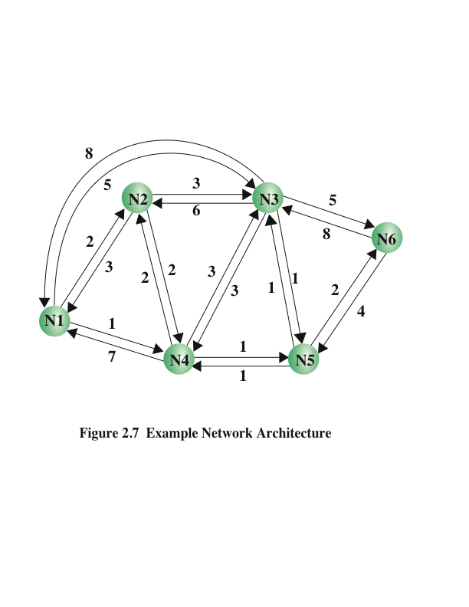
Notes:
Figure 2.7 illustrates a network in which the two arrowed lines between a pair of
nodes represent a link between these nodes, and the corresponding numbers represent
the current link cost in each direction. Our concern, of course, is with an internet, in
which each node is a router and the links between adjacent routers are networks or
direct communications links. The shortest path (fewest hops) from node 1 to node 6
is 1-3-6 (Cost = 5 + 5 = 10), but the least-cost path is 1-4-5-6 (Cost = 1 + 1 + 2 = 4).
Costs are assigned to links to support one or more design objectives. For example,
the cost could be inversely related to the data rate (that is, the higher the data rate on
a link, the lower the assigned cost of the link) or the current link delay. In the first
case, the least-cost route should provide the highest throughput. In the second case,
the least-cost route should minimize delay. Routing decisions can be based on other
criteria as well. For example, a routing policy may dictate that certain types of traffic
be restricted to certain routes for security concerns.

Slide 22
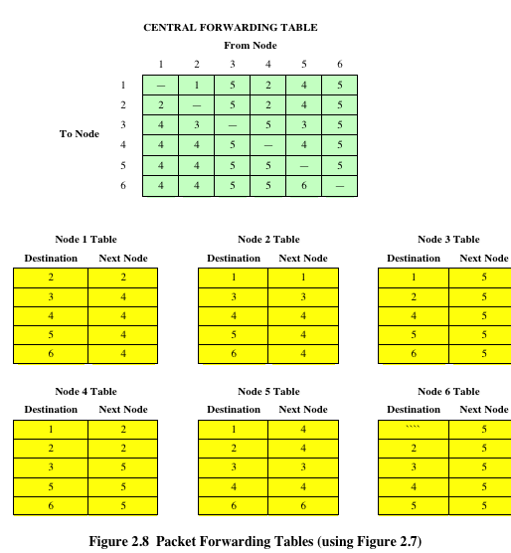
Notes:
The key function of any router is to accept incoming packets and forward them. For
this purpose, a router maintains forwarding tables. Figure 2.8 shows a simplified
example of how this might be implemented for the network, with its associated link
costs, of Figure 2.7. A router’s forwarding table shows, for each destination, the
identity of the next node on the router. Each router may be responsible for discovering
the appropriate routes. Alternatively, a network control center may be responsible for
designing routes for all routers and maintaining a central forwarding table, providing
each router with individual forwarding tables relevant only to that router.
Note that it is not necessary to store the complete route for each possible pair of nodes.
Rather, it is sufficient to know, for each pair of nodes, the identity of the first node on
the route.
In the simple example of Figure 2.8, forwarding decisions are based solely on the
identity of the destination system. Additional information is often used to determine
the forwarding decision, such as the source address, packet flow identifier, or security
level of the packet:
■ Failure: When a node or link fails, it can no longer be used as part of a route.
■ Congestion: When a particular portion of the network is heavily congested,
it is desirable to route packets around rather than through the area of
congestion.
■ Topology change: The insertion of new links or nodes affects routing.
For adaptive routing to be possible, information about the state of the network must be
exchanged among the nodes or between the nodes and a central controller.

Slide 23
Routing Protocols
Routers are responsible for receiving and forwarding packets through the interconnected set of networks
Each router makes routing decisions based on knowledge of the topology and traffic/delay conditions of the internet
A degree of dynamic cooperation is needed among the routers
The router must avoid portions of the network that have failed and should avoid portions of the network that are congested
Notes:
The routers in an internet are responsible for receiving and forwarding packets
through the interconnected set of networks. Each router makes routing decisions based
on knowledge of the topology and traffic/delay conditions of the internet. Accordingly,
a degree of dynamic cooperation is needed among the routers. In particular, the
router must avoid portions of the network that have failed and should avoid portions
of the network that are congested. To make such dynamic routing decisions, routers
exchange routing information using a routing protocol. Information is needed about
the status of the internet, in terms of which networks can be reached by which routes,
and the delay characteristics of various routes.
There are essentially two categories of routing protocols, which are based on the
concept of an autonomous system (AS) . We first define AS and then look at the
two categories. An AS exhibits the following characteristics:
1. An AS is a set of routers and networks managed by a single organization.
2. An AS consists of a group of routers exchanging information via a common
routing protocol.
3. Except in times of failure, an AS is connected (in a graph-theoretic sense); that
is, there is a path between any pair of nodes.
A shared routing protocol, called here an interior router protocol (IRP) , passes
routing information between routers within an AS. The protocol used within the AS
does not need to be implemented outside of the system. This flexibility allows IRPs to
be custom tailored to specific applications and requirements.

Slide 24
Routing Protocols
There are essentially two categories of routing protocols which are based on the concept of an autonomous system (AS)
An AS exhibits the following characteristics:
An AS is a set of routers and networks managed by a single organization
An AS consists of a group of routers exchanging information via a common routing protocol
Except in times of failure, an AS is connected (in a graph-theoretic sense)
An interior router protocol (IRP) is a shared routing protocol that passes routing information between routers within an AS
Notes:
There are essentially two categories of routing protocols, which are based on the
concept of an autonomous system (AS) . We first define AS and then look at the
two categories. An AS exhibits the following characteristics:
1. An AS is a set of routers and networks managed by a single organization.
2. An AS consists of a group of routers exchanging information via a common
routing protocol.
3. Except in times of failure, an AS is connected (in a graph-theoretic sense); that
is, there is a path between any pair of nodes.
A shared routing protocol, called here an interior router protocol (IRP) , passes
routing information between routers within an AS. The protocol used within the AS
does not need to be implemented outside of the system. This flexibility allows IRPs to
be custom tailored to specific applications and requirements.

Slide 25
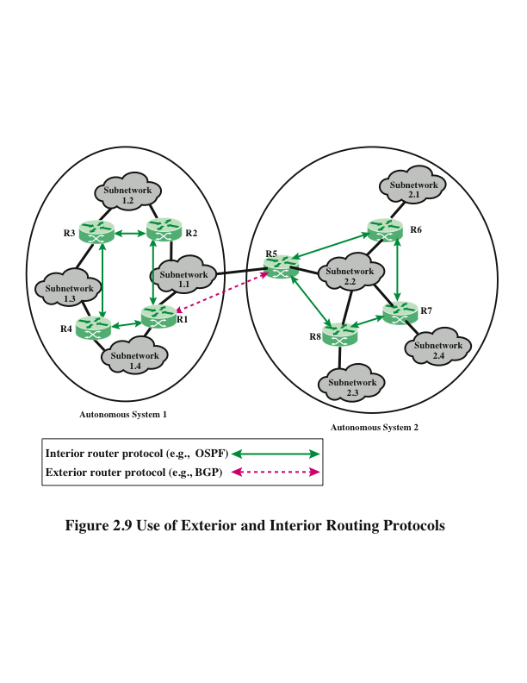
Notes:
It may happen, however, that an internet will be constructed of more than one AS. For
example, all the LANs at a site, such as an office complex or campus, could be linked
by routers to form an AS. This system might be linked through a wide-area network to
other autonomous systems. Figure 2.9 illustrates this situation.
In this case, the routing algorithms and information in routing tables used by routers in
different autonomous systems may differ. Nevertheless, the routers in one AS need at
least a minimal level of information concerning networks outside the system that can
be reached. We refer to the protocol used to pass routing information between routers
in different autonomous systems as an exterior router protocol (ERP) .
You can expect that an ERP will need to pass less information than an IRP for the
following reason. If a packet is to be transferred from a host in one AS to a host in
another AS, a router in the first system need only determine the target AS and devise
a route to get into that target system. Once the packet enters the target AS, the routers
within that system can cooperate to deliver the packet; the ERP is not concerned with,
and does not know about, the details of the route followed within the target AS.

Slide 26
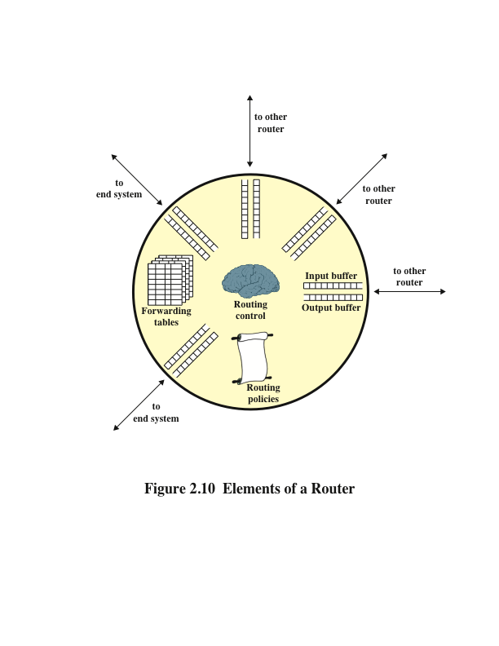
Notes:
Figure 2.10 depicts the principal elements of a router, from the point of view of its
routing function.
Any given router has a number of I/O ports attached to it: one or more to other routers,
and zero or more to end systems. On each port, packets arrive and depart. You can
consider that there are two buffers, or queues, at each port: one to accept arriving
packets, and one to hold packets that are waiting to depart. In practice, there might be
two fixed-size buffers associated with each port, or there might be a pool of memory
available for all buffering activities. In the latter case, you can think of each port
having two variable-size buffers associated with it, subject to the constraint that the
sum of all buffer sizes is a constant.
In any case, as packets arrive, they are stored in the input buffer of the corresponding
port. The router examines each incoming packet, makes a routing decision based on
the forwarding tables, and then moves the packet to the appropriate output buffer.
Packets queued for output are transmitted as rapidly as possible. Each output queue
can be operated as a simple first-in, first-out (FIFO) queue. More commonly, a more
complex queuing discipline is used, to take into account the relative priority of the
queued packets. A set of routing policies may also influence the construction of the
forwarding tables and how various packets are to be treated. Policies may determine
routing not just on the destination address but other factors, such as source address,
packet size, and protocol of the payload.
The final element shown in Figure 2.10 is a routing control function. This function
includes execution of routing protocols, adaptive maintenance of the routing tables,
and supervising congestion control policies.

Slide 27
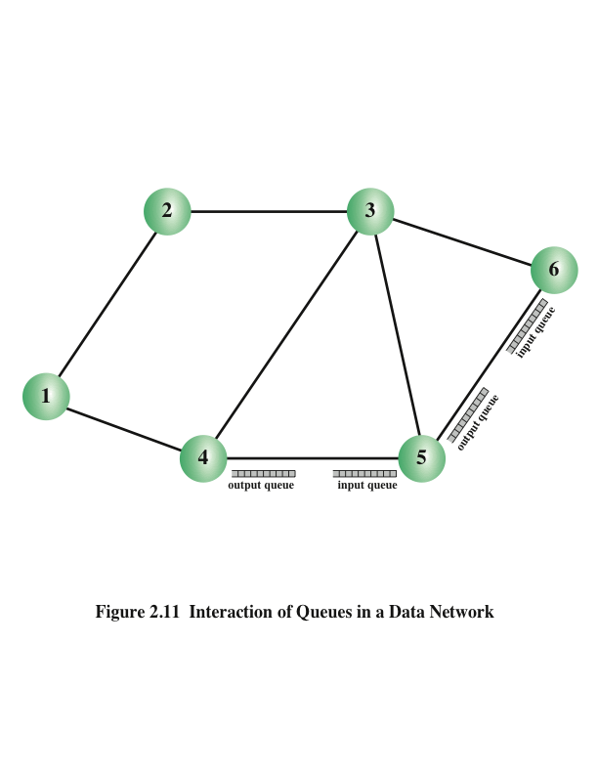
Notes:
If packets arrive too fast for a router to process them (that is, make routing decisions)
or faster than packets can be cleared from the outgoing buffers, eventually packets
will arrive for which no memory is available. When such a saturation point is reached,
one of two general strategies can be adopted. The first such strategy is to discard any
incoming packet for which there is no available buffer space. The alternative is for the
node that is experiencing these problems to exercise some sort of flow control over its
neighbors so that the traffic flow remains manageable. But, as Figure 2.11 illustrates,
each of a node’s neighbors is also managing a number of queues. If node 6 restrains
the flow of packets from node 5, this causes the output buffer in node 5 for the port to
node 6 to fill up. Thus, congestion at one point in the network can quickly propagate
throughout a region or the entire network. Although flow control is indeed a powerful
tool, you need to use it in such a way as to manage the traffic on the entire network.

Slide 28
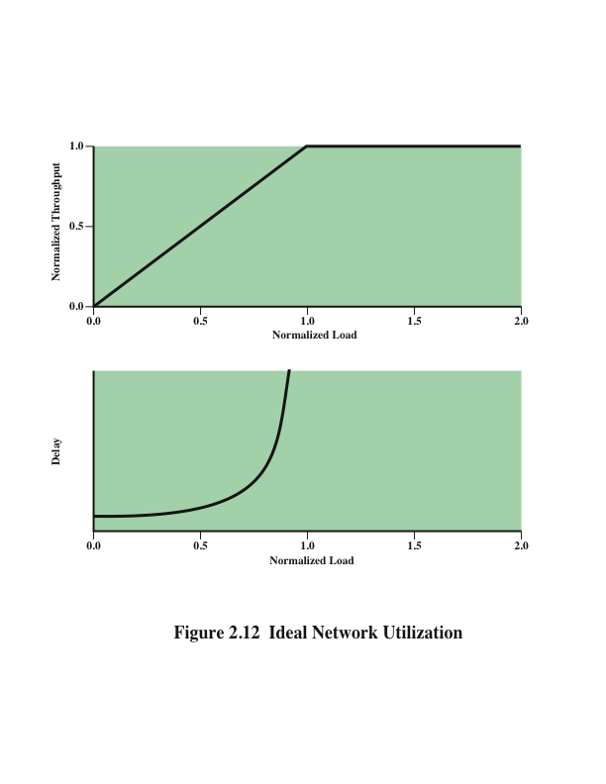
Notes:
Figure 2.12 suggests the ideal goal for network utilization.
The top graph plots the steady-state total throughput (number of packets delivered to
destination end systems) through the network as a function of the offered load (number
of packets transmitted by source end systems), both normalized to the maximum theoretical
throughput of the network. In the ideal case, the throughput of the network
increases to accommodate load up to an offered load equal to the full capacity of
the network; then normalized throughput remains at 1.0 at higher input loads. Note,
however, what happens to the end-to-end delay experienced by the average packet
even with this assumption of ideal performance. At negligible load, there is some
small constant amount of delay that consists of the propagation delay through the
network from source to destination plus processing delay at each node. As the load
on the network increases, queuing delays at each node are added to this fixed amount
of delay. The reason for the increase in delay even when the total network capacity is
not exceeded has to do with the variability in load at each node. With multiple sources
supplying data to the network, even if each source produced packets at fixed intervals,
there will be fluctuation in the input rate at each individual network node. When a
burst of packets arrives at a node, it will take some time to clear the backlog. As it
is clearing the backlog, it is sending out a sustained burst of packets, thus imposing
packet bursts on downstream node. And once a queue builds up at a node, even if
packets only arrive at a rate the node can handle during a given time period, those
packets have to wait their turn in the queue, and thus experience additional delay. This
is a standard result of queuing theory: delays will grow with increasing load if the
arrival rate is not constant.
When the load exceeds the network capacity, delays increase without bound. Here
is a simple intuitive explanation of why delay must go to infinity. Suppose that each
node in the network is equipped with buffers of infinite size and suppose that the input
load exceeds network capacity. Under ideal conditions, the network will continue
to sustain a normalized throughput of 1.0. Therefore, the rate of packets leaving the
network is 1.0. Because the rate of packets entering the network is greater than 1.0,
internal queue sizes grow. In the steady state, with input greater than output, these
queue sizes grow without bound and therefore queuing delays grow without bound.
It is important to grasp the meaning of Figure 2.12 before looking at real-world
conditions. This figure represents the ideal, but unattainable, goal of all traffic and
congestion control schemes. No scheme can exceed the performance depicted in
Figure 2.12.

Slide 29
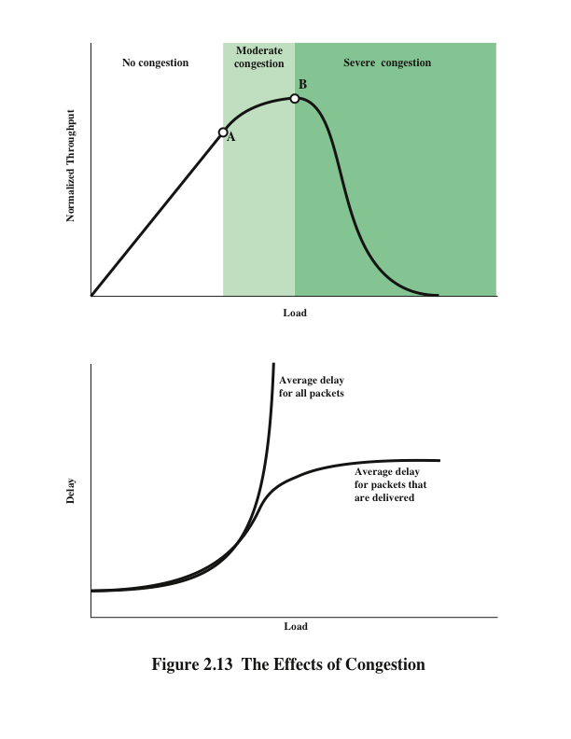
Notes:
The ideal case reflected in Figure 2.12 assumes infinite buffers and no overhead
related to congestion control. In practice, buffers are finite, leading to buffer overflow,
and attempts to control congestion consume network capacity in the exchange of
control signals.
Consider what happens in a network with finite buffers if no attempt is made to
control congestion or to restrain input from end systems. The details, of course,
differ depending on network architecture and on the statistics of the presented traffic;
however, the graphs in Figure 2.13 depict the devastating outcome in general terms.
At light loads, throughput and hence network utilization increases as the offered load
increases. As the load continues to increase, a point is reached (point A in the plot)
beyond which the throughput of the network increases at a rate slower than the rate
at which offered load is increased. This is because of network entry into a moderate
congestion state. In this region, the network continues to cope with the load, although
with increased delays. The departure of throughput from the ideal is accounted for by a
number of factors. For one thing, the load is unlikely to be spread uniformly throughout
the network. Therefore, while some nodes may experience moderate congestion, others
may be experiencing severe congestion and may need to discard traffic. In addition, as
the load increases, the network attempts to balance the load by routing packets through
areas of lower congestion. For the routing function to work, an increased number of
routing messages must be exchanged between nodes to alert each other to areas of
congestion; this overhead reduces the capacity available for data packets.
As the load on the network continues to increase, the queue lengths of the various nodes
continue to grow. Eventually, a point is reached (point B in the plot) beyond which
throughput actually drops with increased offered load. The reason for this is that the
buffers at each node are of finite size. When the buffers at a node become full, the node
must discard packets. Therefore, the sources must retransmit the discarded packets in
addition to new packets. This only exacerbates the situation: As more and more packets
are retransmitted, the load on the system grows, and more buffers become saturated.
While the system is trying desperately to clear the backlog, users are pumping old and
new packets into the system. Even successfully delivered packets may be retransmitted
because it takes too long, at a higher layer (for example, transport layer), to acknowledge
them: The sender assumes the packet did not get through and retransmits. Under these
circumstances, the effective capacity of the system declines to zero.

Slide 30
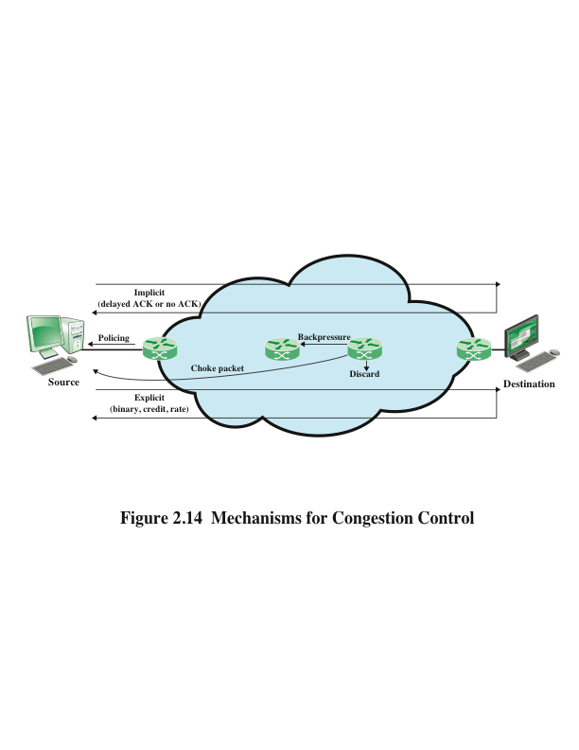
Notes:
Figure 2.14 provides a general depiction of important congestion control techniques.

Slide 31
Backpressure
Can be exerted on the basis of links or logical connections
Flow restriction propagates backward (against the flow of data traffic) to sources, which are restricted in the flow of new packets into the network
Backpressure for all traffic on a particular link is automatically invoked by the flow control mechanisms of data link layer protocols
Backpressure can also be selectively applied to logical connections so that the flow from one node to the next is only restricted or halted on some connections, generally the ones with the most traffic
Used in Frame Relay and Asynchronous Transfer Mode (ATM) networks
Use of these networks has declined considerably in favor of Ethernet carrier networks and IP-based Multiprotocol Label Switching (MPLS) networks
Notes:
Backpressure can be exerted on the basis of links or logical connections (for example,
virtual circuits). Referring again to Figure 2.11, if node 6 becomes congested (buffers
fill up), node 6 can slow down or halt the flow of all packets from node 5 (or node 3,
or both nodes 5 and 3). If this restriction persists, node 5 will need to slow down or
halt traffic on its incoming links. This flow restriction propagates backward (against
the flow of data traffic) to sources, which are restricted in the flow of new packets into
the network.
Backpressure for all traffic on a particular link is automatically invoked by the flow
control mechanisms of data link layer protocols. Backpressure can also be selectively
applied to logical connections, so that the flow from one node to the next is only
restricted or halted on some connections, generally the ones with the most traffic. In
this case, the restriction propagates back along the connection to the source. Such a
mechanism is used in Frame Relay and Asynchronous Transfer Mode (ATM) networks.
However, the use of these networks has declined considerably in favor of Ethernet
carrier networks and IP-based Multiprotocol Label Switching (MPLS) networks.

Slide 32
Choke Packet
A control packet generated at a congested node and transmitted back to a source node to restrict traffic flow
Either a router or a destination end system may send this message to a source end system
On receipt of a choke packet the source host should cut back the rate at which it is sending traffic to the specified destination until it no longer receives choke packets
The choke packet can be used by a router or host that must discard IP datagrams because of a full buffer
The router will issue a choke packet for every packet that it discards
A system may anticipate congestion and issue choke packets when its buffers approach capacity
Receipt of a choke packet does not imply delivery or nondelivery
Notes:
A choke packet is a control packet generated at a congested node and transmitted back
to a source node to restrict traffic flow. Either a router or a destination end system
may send this message to a source end system, requesting that it reduce the rate at
which it is sending traffic to the internet destination. On receipt of a choke packet,
the source host should cut back the rate at which it is sending traffic to the specified
destination until it no longer receives choke packets. The choke packet can be used
by a router or host that must discard IP datagrams because of a full buffer. In that
case, the router or host will issue a choke packet for every packet that it discards. In
addition, a system may anticipate congestion and issue choke packets when its buffers
approach capacity. In that case, the packet referred to in the choke packet may well be
delivered. Therefore, receipt of a choke packet does not imply delivery or nondelivery
of the corresponding packet.

Slide 33
Implicit Congestion Signaling
When network congestion occurs, two things may happen:
The transmission delay for an individual packet from source to destination increases, so that it is noticeably longer than the fixed propagation delay
Packets are discarded
If a source can detect increased delays and packet discards, it has implicit evidence of network congestion
Congestion control on the basis of implicit signaling is the responsibility of end systems and does not require action on the part of network nodes
Is an effective congestion control technique in connectionless, or datagram, networks, such as IP-based internets
Notes:
When network congestion occurs, two things may happen:
1. The transmission delay for an individual packet from source to destination
increases, so that it is noticeably longer than the fixed propagation delay, and
Packets are discarded.
If a source can detect increased delays and packet discards, it has implicit evidence
of network congestion. If all sources can detect congestion and, in response, reduce
flow on the basis of congestion, the network congestion will be relieved. Therefore,
congestion control on the basis of implicit signaling is the responsibility of end
systems and does not require action on the part of network nodes.
Implicit signaling is an effective congestion control technique in connectionless, or
datagram, networks, such as IP-based internets. In such cases, there are no logical
connections through the internet on which flow can be regulated. However, between
the two end systems, logical connections can be established at the TCP level. TCP
includes mechanisms for acknowledging receipt of TCP segments and for regulating
the flow of data between source and destination on a TCP connection.

Slide 34
Explicit Congestion Signaling
Explicit congestion signaling approaches can work in one of two directions:
Backward
Notifies the source that congestion avoidance procedures should be initiated where applicable for traffic in the opposite direction of the received notification
It indicates that the packets that the user transmits on this logical connection may encounter congested resources
Backward information is transmitted either by altering bits in a header of a data packet headed for the source to be controlled or by transmitting separate control packets to the source
Forward
Notifies the user that congestion avoidance procedures should be initiated where applicable for traffic in the same direction as the received notification
It indicates that this packet, on this logical connection, has encountered congested resources
In some schemes, when a forward signal is received by an end system, it echoes the signal back along the logical connection to the source; in other schemes, the end system is expected to exercise flow control upon the source end system at a higher layer
Notes:
It is desirable to use as much of the available capacity in a network as possible but
still react to congestion in a controlled and fair manner. This is the purpose of explicit
congestion avoidance techniques. In general terms, for explicit congestion avoidance,
the network alerts end systems to growing congestion within the network and the end
systems take steps to reduce the offered load to the network.
Explicit congestion signaling approaches can work in one of two directions:
■ Backward: Notifies the source that congestion avoidance procedures should
be initiated where applicable for traffic in the opposite direction of the received
notification. It indicates that the packets that the user transmits on this logical
connection may encounter congested resources. Backward information is transmitted
either by altering bits in a header of a data packet headed for the source
to be controlled or by transmitting separate control packets to the source.
■ Forward : Notifies the user that congestion avoidance procedures should be
initiated where applicable for traffic in the same direction as the received notification.
It indicates that this packet, on this logical connection, has encountered
congested resources. Again, this information may be transmitted either
as altered bits in data packets or in separate control packets. In some schemes,
when a forward signal is received by an end system, it echoes the signal back
along the logical connection to the source. In other schemes, the end system is
expected to exercise flow control upon the source end system at a higher layer
(for example, TCP).

Slide 35
Categories of explicit congestion signaling approaches:
Binary
A bit is set in a data packet as it is forwarded by the congested node; when a source receives a binary indication of congestion on a logical connection, it may reduce its traffic flow
Credit based
These schemes are based on providing an explicit credit to a source over a logical connection; the credit indicates how many octets or how many packets the source may transmit
Common for end-to-end flow control, in which a destination system uses credit to prevent the source from overflowing the destination buffers
Defined in Frame Relay and ATM networks
Rate based
These schemes are based on providing an explicit data rate limit to the source over a logical connection
The source may transmit data at a rate up to the set limit
To control congestion, any node along the path of the connection can reduce the data rate limit in a control message to the source
Notes:
You can divide explicit congestion signaling approaches into three general categories:
■ Binary: A bit is set in a data packet as it is forwarded by the congested node.
When a source receives a binary indication of congestion on a logical connection,
it may reduce its traffic flow.
■ Credit based: These schemes are based on providing an explicit credit to
a source over a logical connection. The credit indicates how many octets or
how many packets the source may transmit. When the credit is exhausted, the
source must await additional credit before sending additional data. Credit-based
schemes are common for end-to-end flow control, in which a destination
system uses credit to prevent the source from overflowing the destination
buffers, but credit-based schemes have also been considered for congestion
control. Credit-based schemes are defined in Frame Relay and ATM networks.
■ Rate based: These schemes are based on providing an explicit data rate limit
to the source over a logical connection. The source may transmit data at a rate
up to the set limit. To control congestion, any node along the path of the connection
can reduce the data rate limit in a control message to the source.

Slide 36
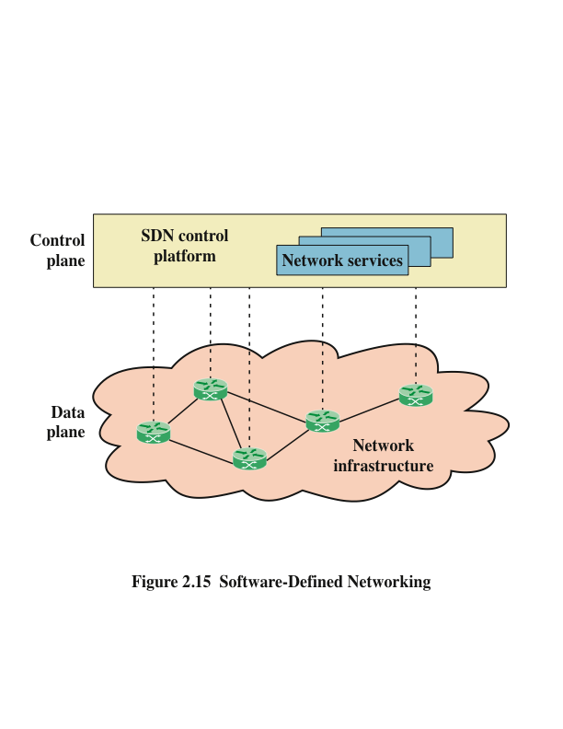
Notes:
With the ever-increasing volume and variety of network traffic, generated by such
high-demand sources as big data, cloud computing, and mobile traffic, it becomes
increasingly difficult to meet stringent QoS and QoE requirements. Networks need
to be more adaptable and scalable. To provide adaptability and scalability, two key
technologies that are rapidly being deployed by a variety of network service and application
providers are software-defined networking (SDN) and network functions virtualization
(NFV). Because these two topics occupy a large portion of this book, only a
brief introduction is appropriate here.
SDN has reached a tipping point at which it is replacing the traditional networking
model. Software-defined networks provide an enhanced level of flexibility and
customizability to meet the needs of newer networking and IT trends such as cloud,
mobility, social networking, and video.
The two elements involved in forwarding packets through routers are a control
function, which decides the route the traffic takes and the relative priority of traffic,
and a data function, which forwards data based on control-function policy. Prior to
SDN, these functions were performed in an integrated fashion at each network device
(router, bridge, packet switch, and so on). Control in such a traditional network is
exercised by means of a routing and control network protocol that is implemented in
each network node. This approach is relatively inflexible and requires all the network
nodes to implement the same protocols. With SDN, a central controller performs all
complex functionality, including routing, naming, policy declaration, and security
checks (see Figure 2.15).
This constitutes the SDN control plane , and consists of one or more SDN controllers.
The SDN controller defines the data flows that occur in the SDN data plane. Each flow
through the network is configured by the controller, which verifies that the communication
is permissible by the network policy. If the controller allows a flow requested
by an end system, it computes a route for the flow to take, and adds an entry for that
flow in each of the switches along the path. With all complex function subsumed by
the controller, switches simply manage flow tables whose entries can only be populated
by the controller. The switches constitute the data plane . Communication
between the controller and the switches uses a standardized protocol.

Slide 37
Software-Defined Networking (SDN)
A driving factor for SDN is the increasingly widespread use of server virtualization
In essence, server virtualization masks server resources from server users, making it possible to partition a single machine into multiple, independent servers, conserving hardware resources
It also makes it possible to quickly migrate a server from one machine to another for load balancing or for dynamic switchover in the case of machine failure
Server virtualization has become a central element in dealing with big data applications and in implementing cloud computing infrastructures
Notes:
One driving factor for SDN is the increasingly widespread use of server virtualization.
In essence, server virtualization masks server resources, including the number and
identity of individual physical servers, processors, and operating systems, from server
users. This makes it possible to partition a single machine into multiple, independent
servers, conserving hardware resources. It also makes it possible to quickly migrate
a server from one machine to another for load balancing or for dynamic switchover
in the case of machine failure. Server virtualization has become a central element in
dealing with big data applications and in implementing cloud computing infrastructures.
But it creates problems with traditional network architectures. One problem is
configuring virtual LANs. Network managers need to make sure the VLAN used by
the virtual machine (VM) is assigned to the same switch port as the physical server
running the VM. But with the VM being movable, it is necessary to reconfigure the
VLAN every time that a virtual server is moved. In general terms, to match the flexibility
of server virtualization, the network manager needs to be able to dynamically
add, drop, and change network resources and profiles. This is difficult to do with
conventional network switches, in which the control logic for each switch is collocated
with the switching logic.
Another effect of server virtualization is that traffic flows differ substantially from
the traditional client/server model. Typically, there is a considerable amount of traffic
among virtual servers, for such purposes as maintaining consistent images of database
and invoking security functions such as access control. These server-to-server flows
change in location and intensity over time, demanding a flexible approach to managing
network resources.
Another factor leading to the need for rapid response in allocating network resources
is the increasing use by employees of mobile devices, such as smartphones, tablets,
and notebooks to access enterprise resources. These devices can add fast-changing
and unpredictable large loads on the network, and can rapidly change their network
attachment point. Network managers must be able to respond to rapidly changing
resource, QoS, and security requirements for mobile devices.
Existing network infrastructures can respond to changing requirements for the
management of traffic flows, providing differentiated QoS levels and security levels
for individual flows, but the process can be very time-consuming if the enterprise
network is large or involves network devices from multiple vendors. The network
manager must configure each vendor’s equipment separately, and adjust performance
and security parameters on a per-session, per-application basis. In a large enterprise,
every time a new VM is brought up, it can take hours or even days for network
managers to do the necessary reconfiguration.

Slide 38
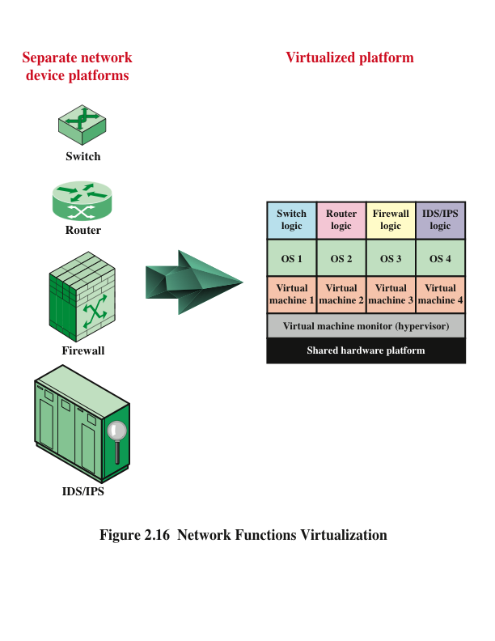
Notes:
The discussion of SDN mentioned that a key driving factor in the deployment of
SDN is the need to provide flexible network response to the widespread use of virtualized
servers. VM technology over the Internet or an enterprise network has, until
recently, been used for application-level server functions such as database servers,
cloud servers, web servers, e-mail servers, and so on. This same technology, however,
can equally be applied to network devices, such as routers, LAN switches, firewalls,
and IDS/IPS servers (see Figure 2.16).
Network functions virtualization (NFV) decouples network functions, such
as routing, firewalling, intrusion detection, and Network Address Translation from
proprietary hardware platforms and implements these functions in software. It utilizes
standard virtualization technologies that run on high-performance hardware to virtualize
network functions. It is applicable to any data plane processing or control plane
function in both wired and wireless network infrastructures.
NFV has a number of features in common with SDN. They share the following
objectives:
■ Move functionality to software
■ Use commodity hardware platforms instead of proprietary platforms
■ Use standardized or open application program interfaces (APIs)
■ Support more efficient evolution, deployment, and repositioning of network
Functions
NFV and SDN are independent but complementary schemes. SDN decouples the
data and control planes of network traffic control, making the control and routing of
network traffic more flexible and efficient. NFV decouples network functions from
specific hardware platforms via virtualization to make the provision of these functions
more efficient and flexible. Virtualization can be applied to the data plane functions
of the routers and other network functions, including SDN controller functions. So,
either can be used alone, but the two can be combined to reap greater benefits.

Slide 39
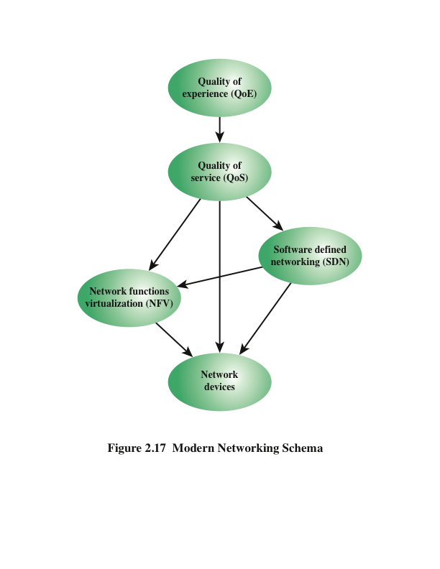
Notes:
This chapter ends with a rough depiction of how the major elements of modern
networking treated in this book fit together (see Figure 2.17). The discussion that
follows works through this figure from the bottom up.
Ultimately, the concern of a network service provider is about the set of network
devices (such as routers) and the control and management of the functions they
perform (such as packet forwarding). If NFV is used, these network functions are
implemented in software and executed on VMs. If instead the network functions are
implemented on dedicated machines and SDN is used, the control functions are implemented
on central SDN controllers, which interact with the network devices.
However, SDN and NFV are not mutually exclusive. If both SDN and NFV are implemented
for a network, the following relationships hold:
■ Network data plane functionality is implemented on VMs.
■ The control plane functionality may be implemented on a dedicated SDN platform
or on an SDN VM.
In either case, the SDN controller interacts with the data plane functions running on
VMs.
QoS measures are commonly used to specify the service required by various network
customers or users and to dictate the traffic management policies used on the network.
The common case, until recently, is that QoS was implemented on network that
used neither NFV nor SDN. In this case, routing and traffic control policies must be
configured directly on network devices using a variety of automated and manual techniques.
If NFV but not SDN is implemented, the QoS settings are communicated to
the VMs. With SDN, regardless of whether NFV is used, it is the SDN controller that
is responsible for enforcing QoS parameters for the various network users.
If QoE considerations come into play, these are used to adjust QoS parameters tosatisfy the users’ QoE requirements.

Slide 40
End of Chapter 2

